Slide 1
Multiple inheritance in Java by interface
If a class implements multiple interfaces is known as multiple inheritance.
interface
interface
implements
implements
class

Slide 2
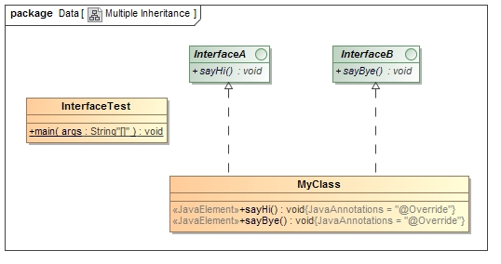
Multiple inheritance in Java by interface

